Slide 1

MONTE CARLO METHOD

Slide 2
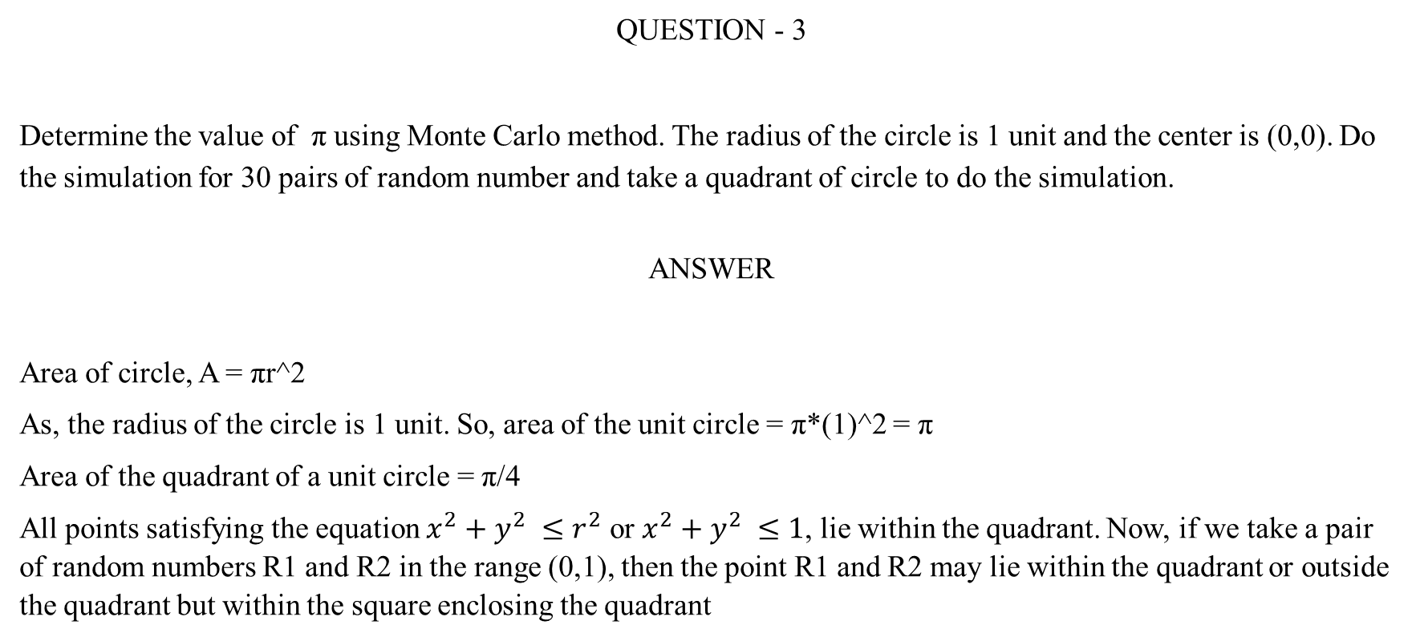
MONTE CARLO METHOD
QUESTION - 3
Determine the value of π using Monte Carlo method. The radius of the circle is 1 unit and the center is (0,0). Do the simulation for 30 pairs of random number and take a quadrant of circle to do the simulation.
ANSWER
Area of circle, A = πr^2
As, the radius of the circle is 1 unit. So, area of the unit circle = π*(1)^2 = π
Area of the quadrant of a unit circle = π/4
All points satisfying the equation $x^{2}+y^{2} ≤r^{2}$ or $x^{2}+y^{2} ≤1$, lie within the quadrant. Now, if we take a pair of random numbers R1 and R2 in the range (0,1), then the point R1 and R2 may lie within the quadrant or outside the quadrant but within the square enclosing the quadrant

Slide 3
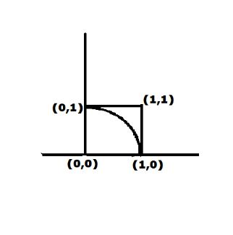
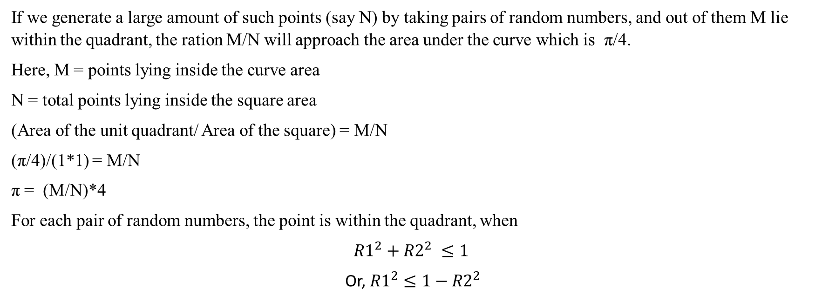
MONTE CARLO METHOD
If we generate a large amount of such points (say N) by taking pairs of random numbers, and out of them M lie within the quadrant, the ration M/N will approach the area under the curve which is π/4.
Here, M = points lying inside the curve area
N = total points lying inside the square area
(Area of the unit quadrant/ Area of the square) = M/N
(π/4)/(1*1) = M/N
π = (M/N)*4
For each pair of random numbers, the point is within the quadrant, when
$${R1}^{2}+{R2}^{2} ≤1$$
Or, ${R1}^{2}≤1−{R2}^{2}$

Slide 4
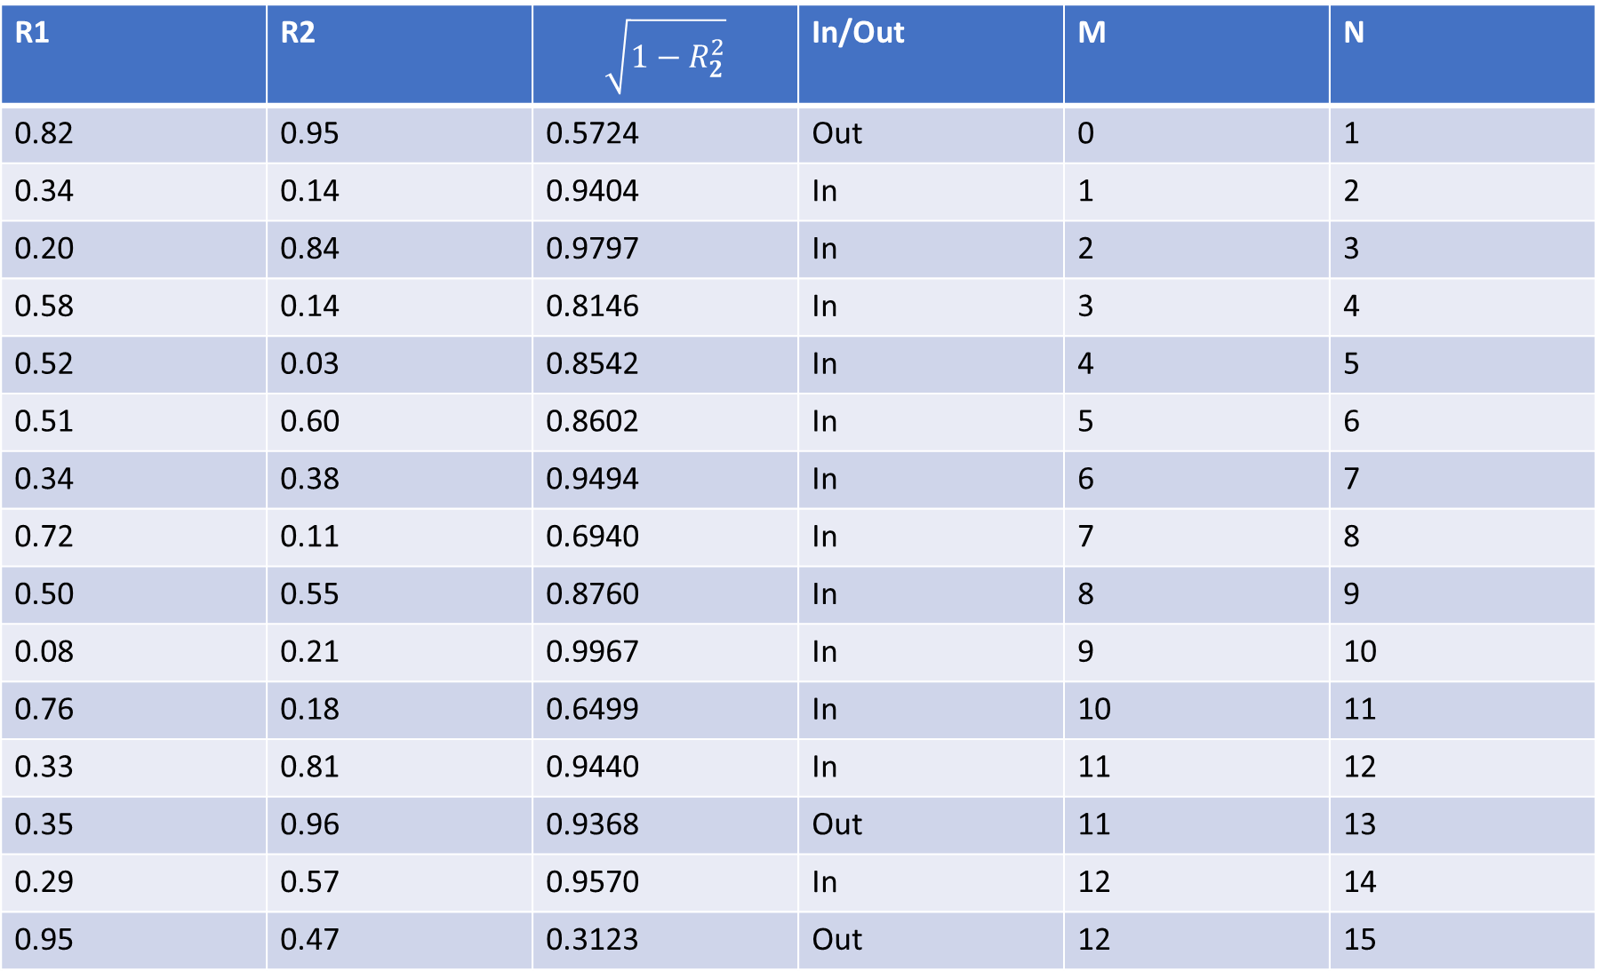
R1 | R2 | $$\sqrt{1−R_{2}^{2}}$$ | In/Out | M | N
0.82 | 0.95 | 0.5724 | Out | 0 | 1
0.34 | 0.14 | 0.9404 | In | 1 | 2
0.20 | 0.84 | 0.9797 | In | 2 | 3
0.58 | 0.14 | 0.8146 | In | 3 | 4
0.52 | 0.03 | 0.8542 | In | 4 | 5
0.51 | 0.60 | 0.8602 | In | 5 | 6
0.34 | 0.38 | 0.9494 | In | 6 | 7
0.72 | 0.11 | 0.6940 | In | 7 | 8
0.50 | 0.55 | 0.8760 | In | 8 | 9
0.08 | 0.21 | 0.9967 | In | 9 | 10
0.76 | 0.18 | 0.6499 | In | 10 | 11
0.33 | 0.81 | 0.9440 | In | 11 | 12
0.35 | 0.96 | 0.9368 | Out | 11 | 13
0.29 | 0.57 | 0.9570 | In | 12 | 14
0.95 | 0.47 | 0.3123 | Out | 12 | 15

Slide 5
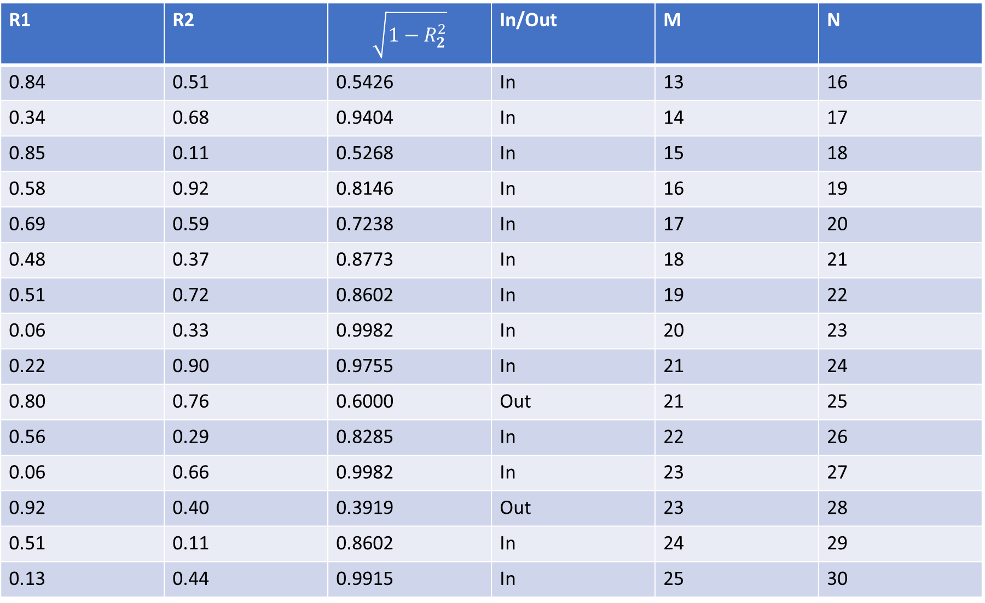
R1 | R2 | $$\sqrt{1−R_{2}^{2}}$$ | In/Out | M | N
0.84 | 0.51 | 0.5426 | In | 13 | 16
0.34 | 0.68 | 0.9404 | In | 14 | 17
0.85 | 0.11 | 0.5268 | In | 15 | 18
0.58 | 0.92 | 0.8146 | In | 16 | 19
0.69 | 0.59 | 0.7238 | In | 17 | 20
0.48 | 0.37 | 0.8773 | In | 18 | 21
0.51 | 0.72 | 0.8602 | In | 19 | 22
0.06 | 0.33 | 0.9982 | In | 20 | 23
0.22 | 0.90 | 0.9755 | In | 21 | 24
0.80 | 0.76 | 0.6000 | Out | 21 | 25
0.56 | 0.29 | 0.8285 | In | 22 | 26
0.06 | 0.66 | 0.9982 | In | 23 | 27
0.92 | 0.40 | 0.3919 | Out | 23 | 28
0.51 | 0.11 | 0.8602 | In | 24 | 29
0.13 | 0.44 | 0.9915 | In | 25 | 30

Slide 6
MONTE CARLO METHOD
Out of 30 points, 25 points lie within the quadrant, giving the value as,
π = (25/30) * 4
= 3.33

